Slide 1

How to use AI to generate notes from a recorded MS Teams meeting

Slide 2
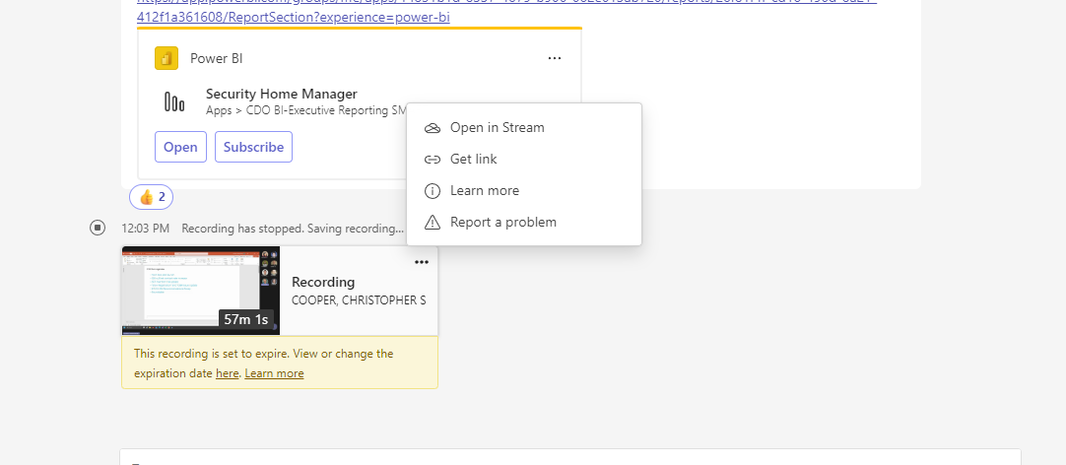
You must record the meeting in Teams to use the AI tool
Once your recording posts in Teams, click the “…” in the top right corner and then select “Open in Stream” which will take you to the Stream webpage

Slide 3
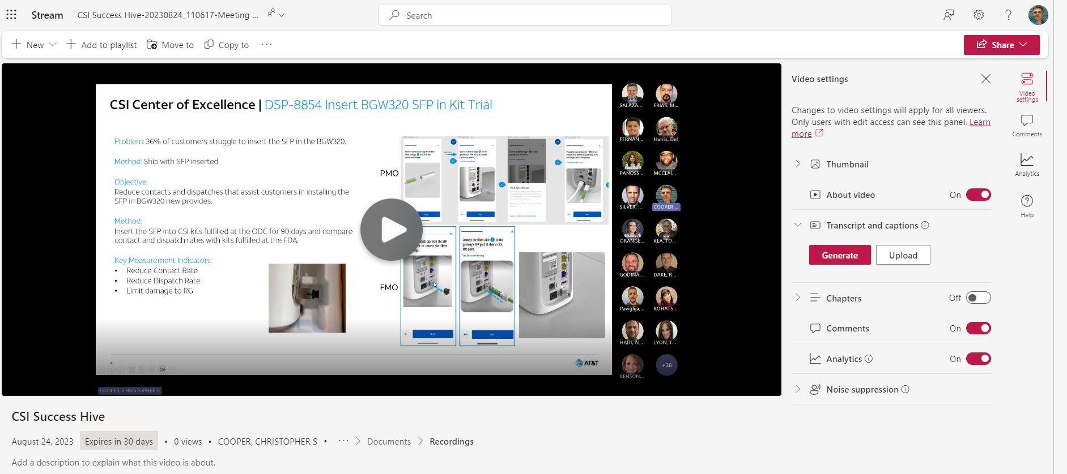
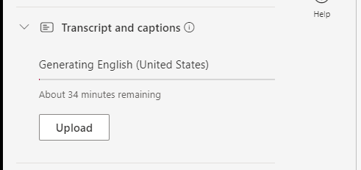
Step 3: A Box will pop up in middle of screen, select English. You will then see the Transcript area to the right provide a status bar showing progress and est time (can take 15+ mins to complete
Step 1: Click “Video Settings”
Step 2: Click on Information button by “Transcript and Captions” to bring up Generate Button. Click on Generate

Slide 4
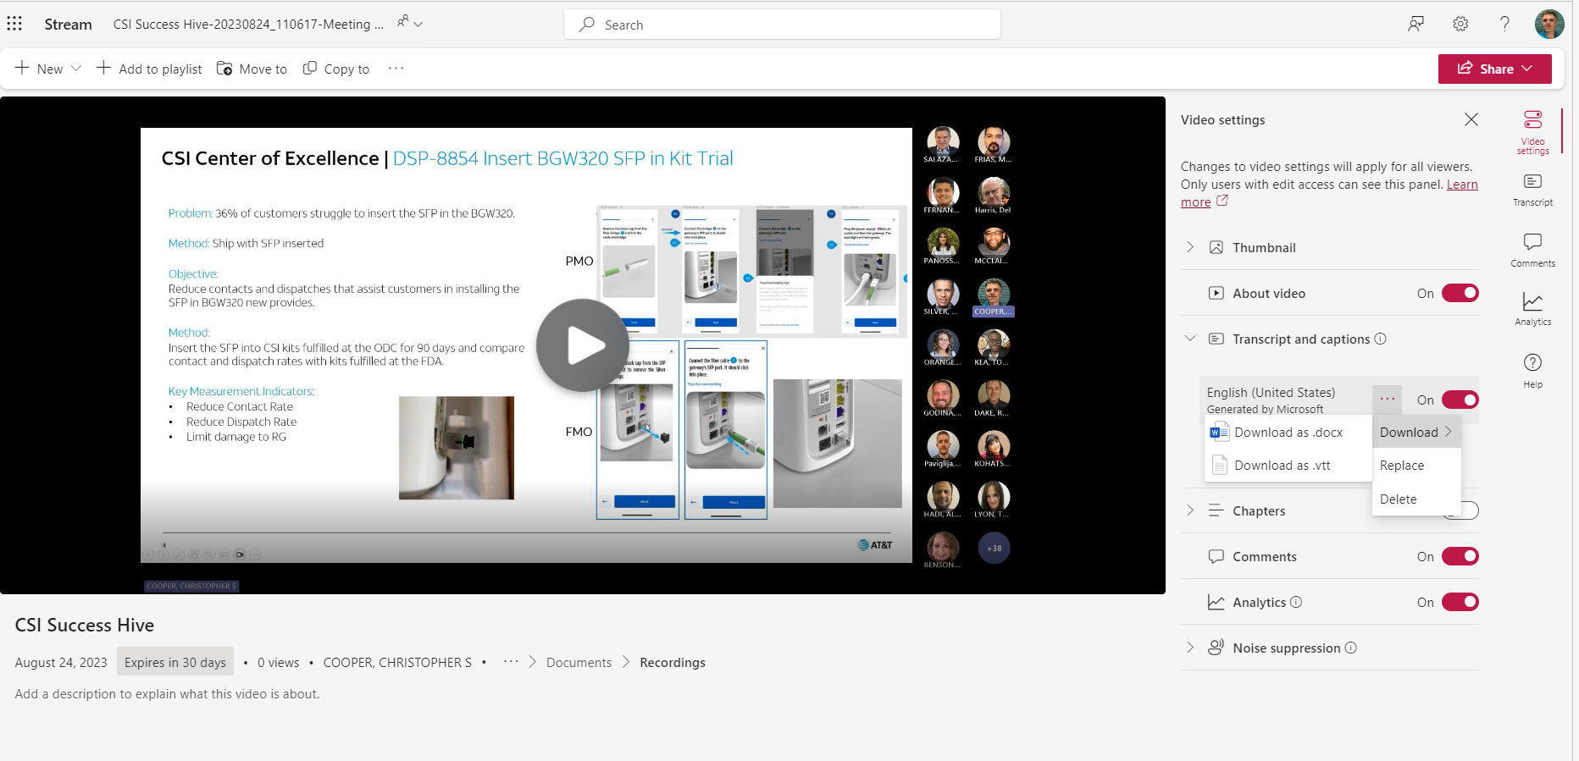
Step 4: Once transcript is created press the “…” buttons and then select Download and then Download as .vtt file

Slide 5
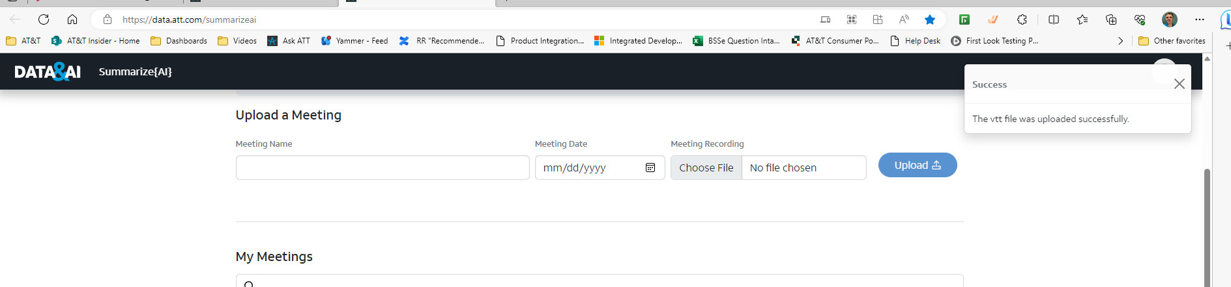
Data & AI / Home (att.com) - This is the direct link to Summarize{AI} or it’s linked at the top of AskAT&T page as well
Step 5: Give your meeting a name, select the date and then click Choose file. Navigate to your download folder where you should see the .vtt file you created in the previous steps. Once selected press the upload button

Slide 6
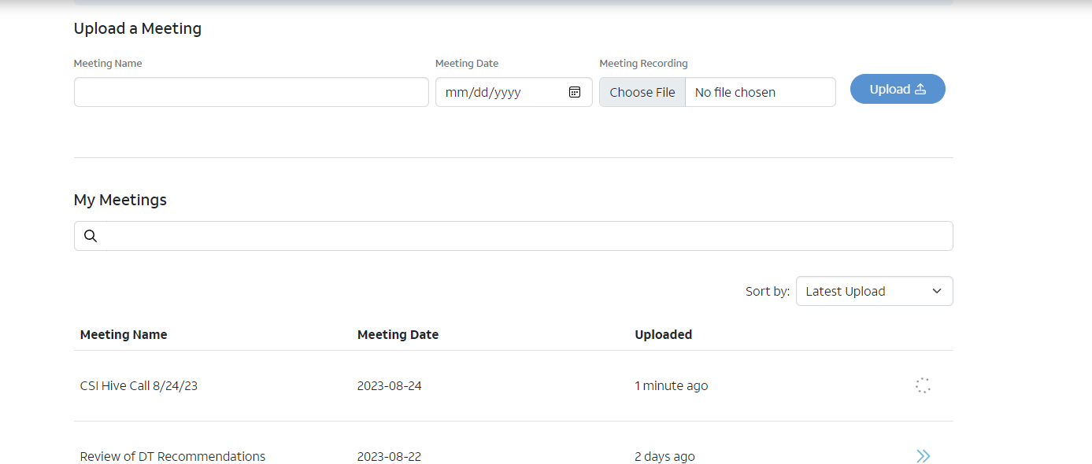
Step 6: The AI engine is now analyzing the .vtt transcript. You will see a spinning wheel here as it progresses it will take a few minutes for the task to complete. Once it does you will see the 2 blue arrows like you see in the screen shot

Slide 7
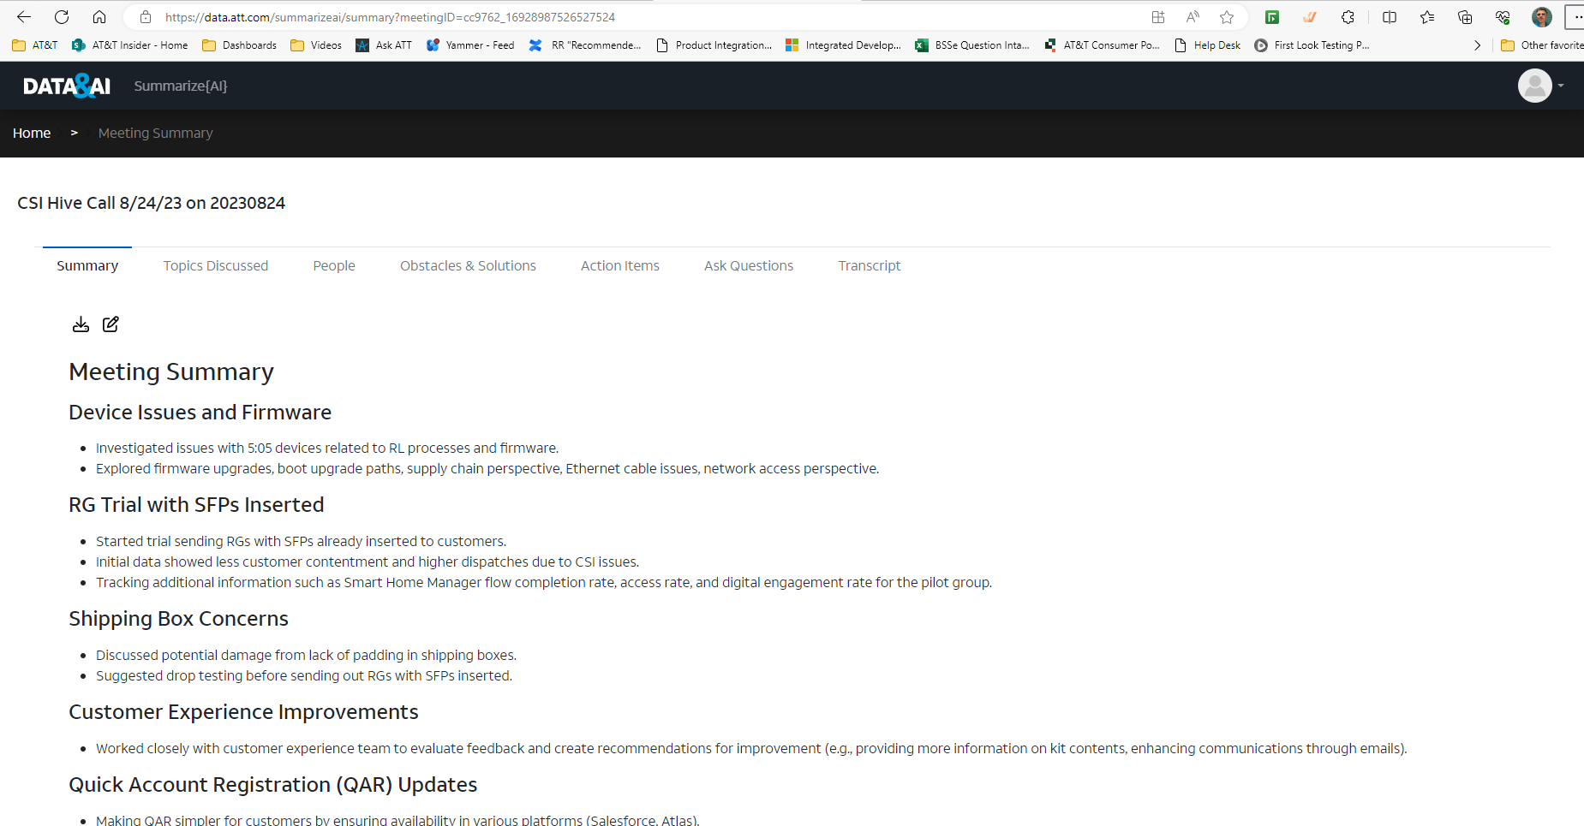
The AI tool provides not only a summary of the call but also other recaps of the meeting that you can select in the top bar. You can change/add/delete any items in the summary by selecting the Markdown button

Slide 8
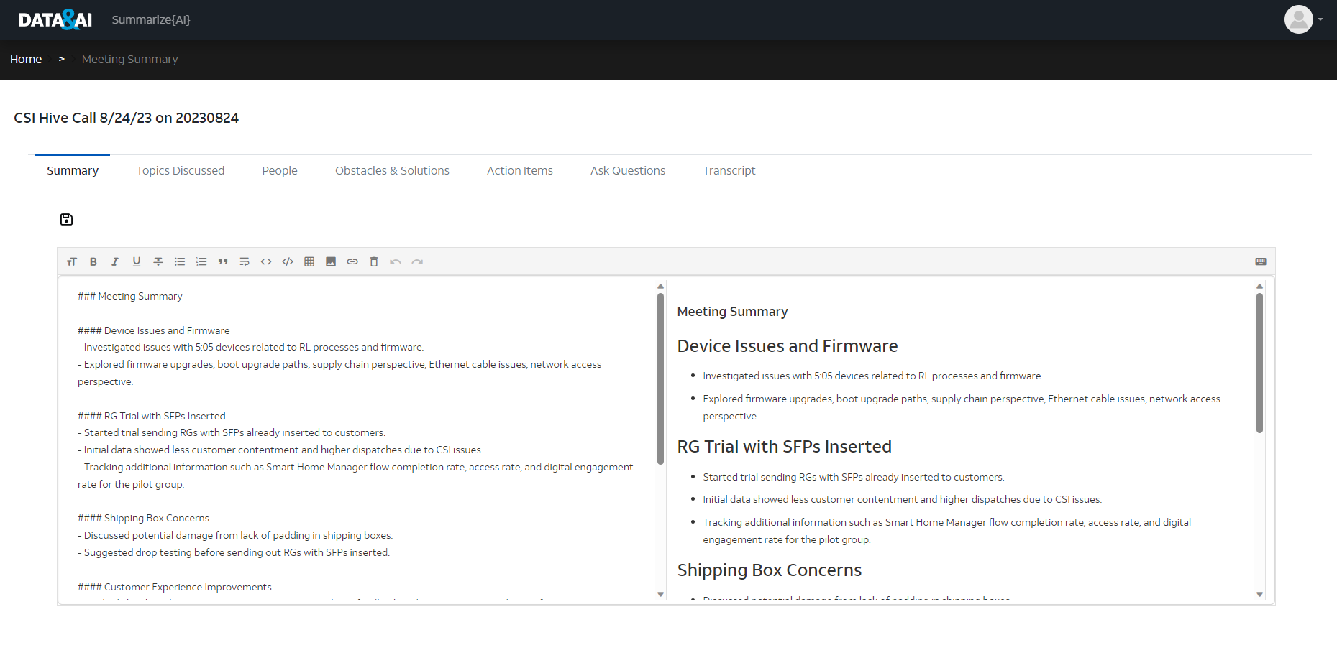
After selecting the Markdown Icon you will be presented with a split screen. Make your changes in the left hand side. The right will show you the text with changes included. You can then download a PDF or do a cut and paste of the right hand side and your AI generated notes are complete.

Slide 9
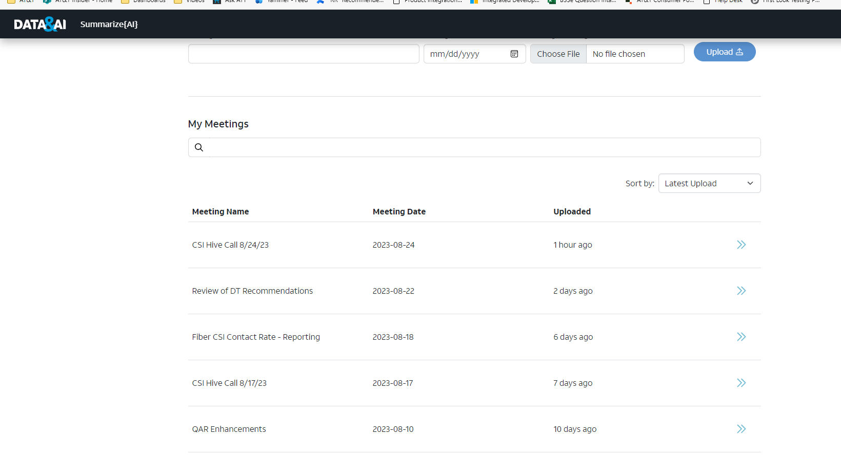
Another nice feature is all the previous notes that were generated are kept in the Summarize{AI} site. So they are all together in one place. I don’t know how long or how many meetings can be kept here however so user beware!
Hope this helps, AI technology is cool!!!!

